Slide 1
Basic statistical review
Chi-square test, t-test, correlations

Slide 2
Recap

Slide 3
Basic statistical review
Chi-square test, t-test, correlations

Slide 4
Lung cancer epidemiology
1922: 617 deaths from lung cancer in the UK
1947: 9287 deaths from lung cancer in the UK

Slide 5


Slide 6
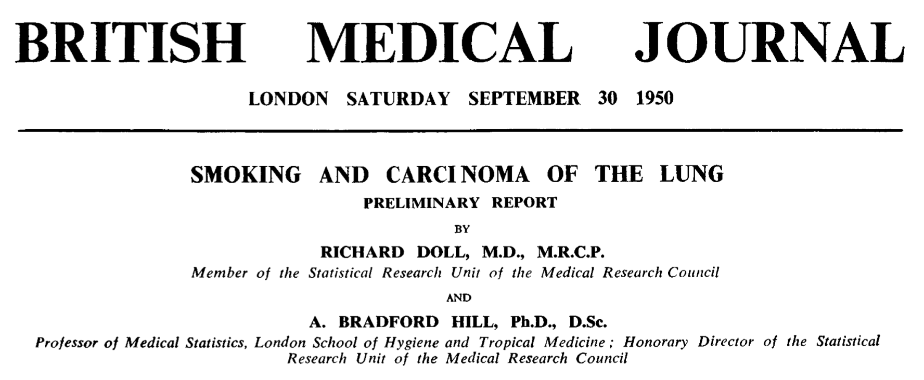
Doll and Hill’s study

Slide 7
Doll and Hill’s study
April 1948 to October 1949 2370 cases reported
150 over 75 and 80 incorrectly diagnosed
408 could not be interviewed for various reasons

Slide 8
Doll and Hill’s study
1723 patients with carcinoma interviewed
743 general medical or surgical patients interviewed as controls for lung cancer patients
Some carcinoma patients later proved to be misdiagnosed

Slide 9
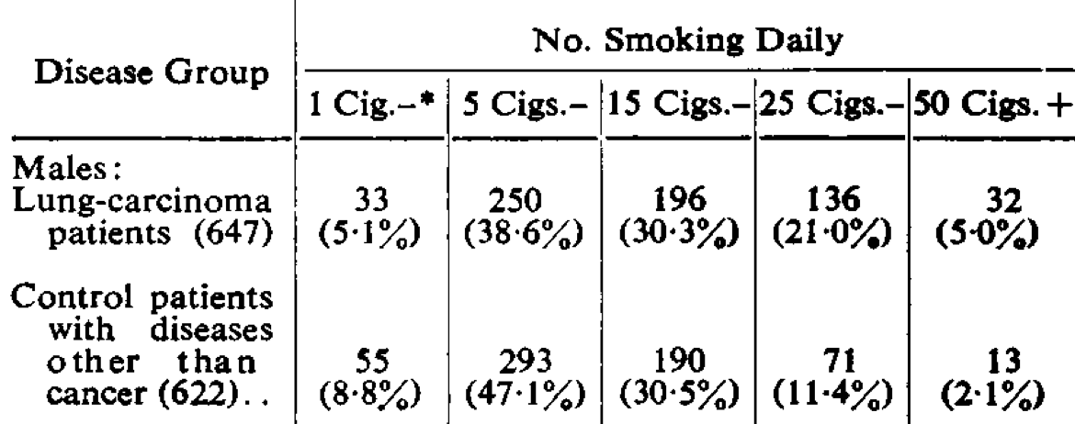
Comparison of amounts smoked between lung cancer patients and controls

Slide 10
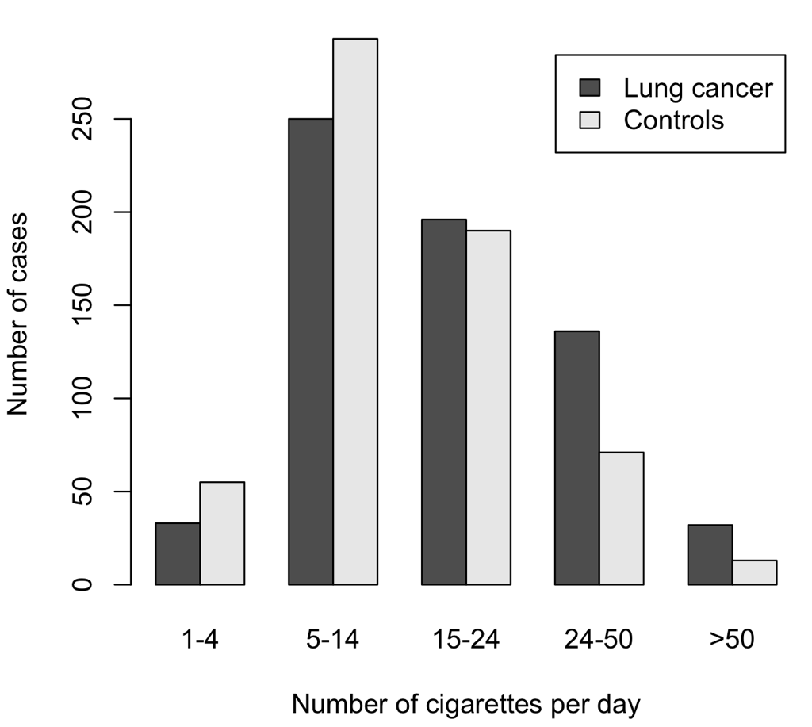

Slide 11
Contingency table
Number of cigs | 1-4 | 5-14 | 15-24 | 25-49 | 50+
Lung cancer | 33 | 250 | 196 | 136 | 32
Control | 55 | 293 | 190 | 71 | 13

Slide 12
Contingency table
Number of cigs | 1-4 | 5-14 | 15-24 | 25-49 | 50+ | Total
Lung cancer | 33 | 250 | 196 | 136 | 32 | 647
Control | 55 | 293 | 190 | 71 | 13 | 622
Total | 88 | 543 | 386 | 207 | 45 | 1269

Slide 13
Expected value
For each cell in the table, the
expected value is:
Column total X Row total
Grand total

Slide 14
Contingency table
Number of cigs | 1-4 | 5-14 | 15-24 | 25-49 | 50+ | Total
Lung cancer | 33 | 250 | 196 | 136 | 32 | 647
Control | 55 | 293 | 190 | 71 | 13 | 622
Total | 88 | 543 | 386 | 207 | 45 | 1269
Expected value for highlighted cell is:
88x647
1269
44.87

Slide 15
Deviation from expected
33-44.87 = -11.87
We can calculate this for each cell in the table
and get an indication of the extent by which the
observed values deviate from the expected ones

Slide 16
Deviation from expected
Number of cigs | 1-4 | 5-14 | 15-24 | 25-49 | 50+
Lung cancer | -11.87 | -26.84 | -0.8 | 30.46 | 9.06
Control | 11.87 | 26.84 | 0.8 | -30.46 | -9.06

Slide 17
Deviation from the expected
For each cell, we calculate:
(observed-expected)²
expected
The sum of these is 36.95

Slide 18
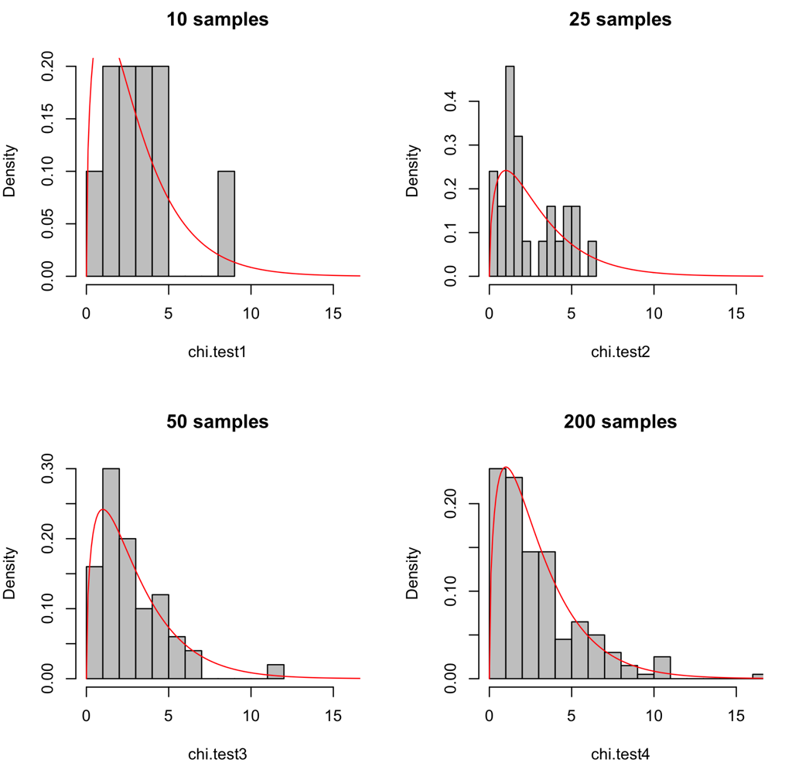
10, 25, 50 and 200 random draws from standard normal distribution, squared and summed and compared to Chi-square probability distribution

Slide 19
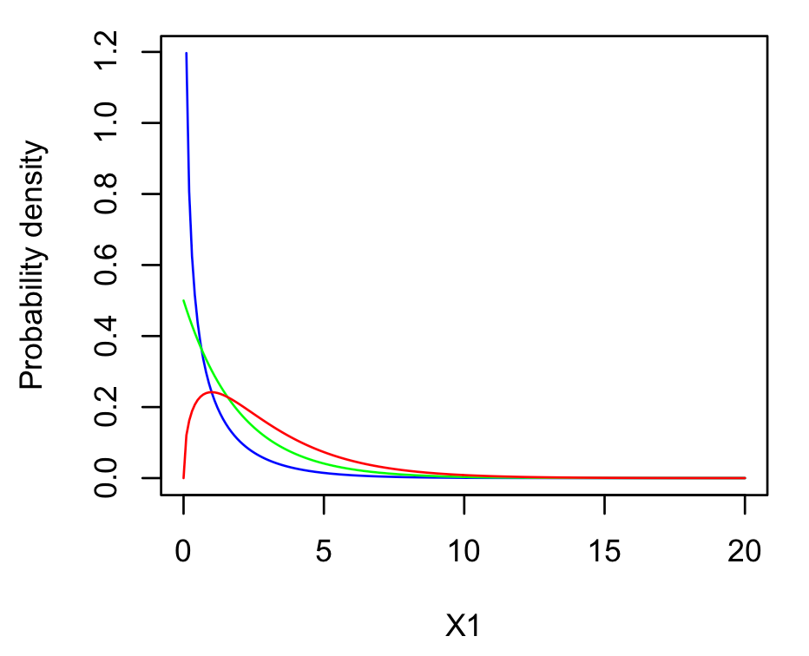
Chi-squared distribution
Blue = 1df
Green = 2 df
Red = 3 df

Slide 20
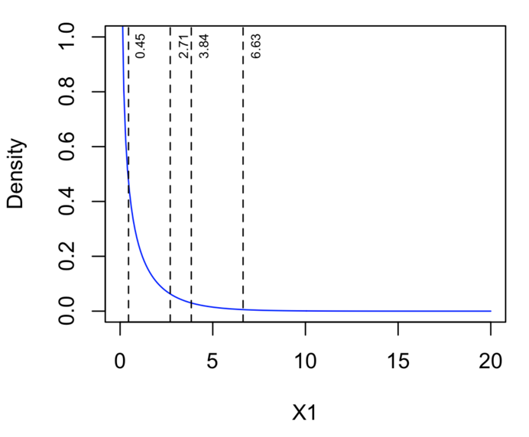
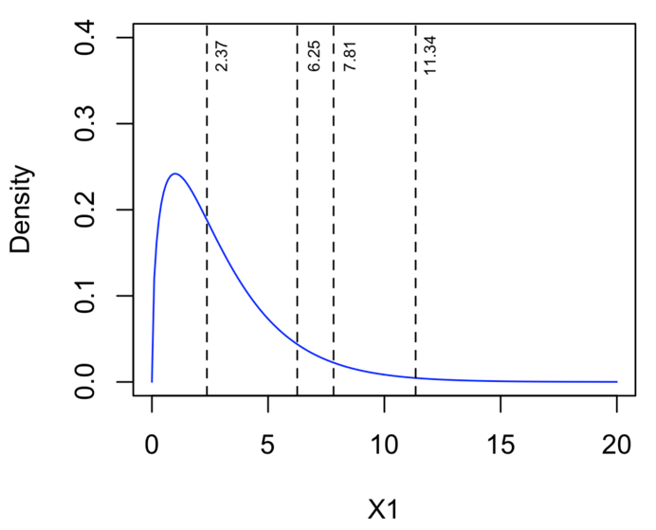
Probability density function for Chi square
distribution with 1 df. 50%, 90%, 95% and 99%
quantiles are marked.
Probability density function for Chi square
distribution with 3 df. 50%, 90%, 95% and 99%
quantiles are marked.

Slide 21
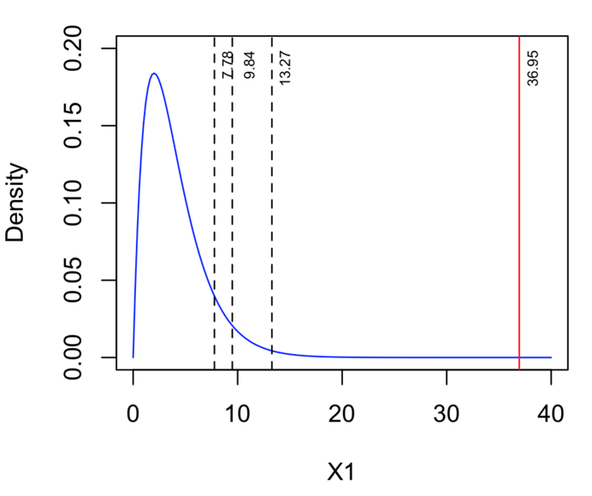
Probability density function for Chi square
distribution with 4 df. 90%, 95% and 99%
quantiles are marked. The test statistic from
our lung cancer analysis is in red.

Slide 22
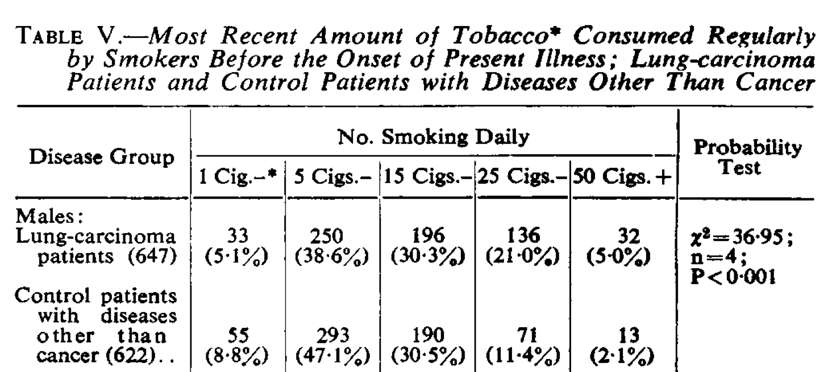

Slide 23
In R:
use chisq.test
> lungs<-matrix(data=c(33,250,196,136,32,55,293,190,71,13), byrow=TRUE, nrow=2)
> chisq.test(lungs)
Pearson's Chi-squared test
data: lungs
X-squared = 36.953, df = 4, p-value = 1.842e-07

Slide 24
Basic statistical review
Chi-square test, t-test, correlations

Slide 25
A test of corticosterone levels in rutting stags
Study to investigate whether rutting causes elevated corticosterone levels in stags, and what levels of corticosterone are found in does
Stags darted and blood samples taken before and during the rut, from the same 25 individuals
Does darted and blood samples taken during the rut

Slide 26
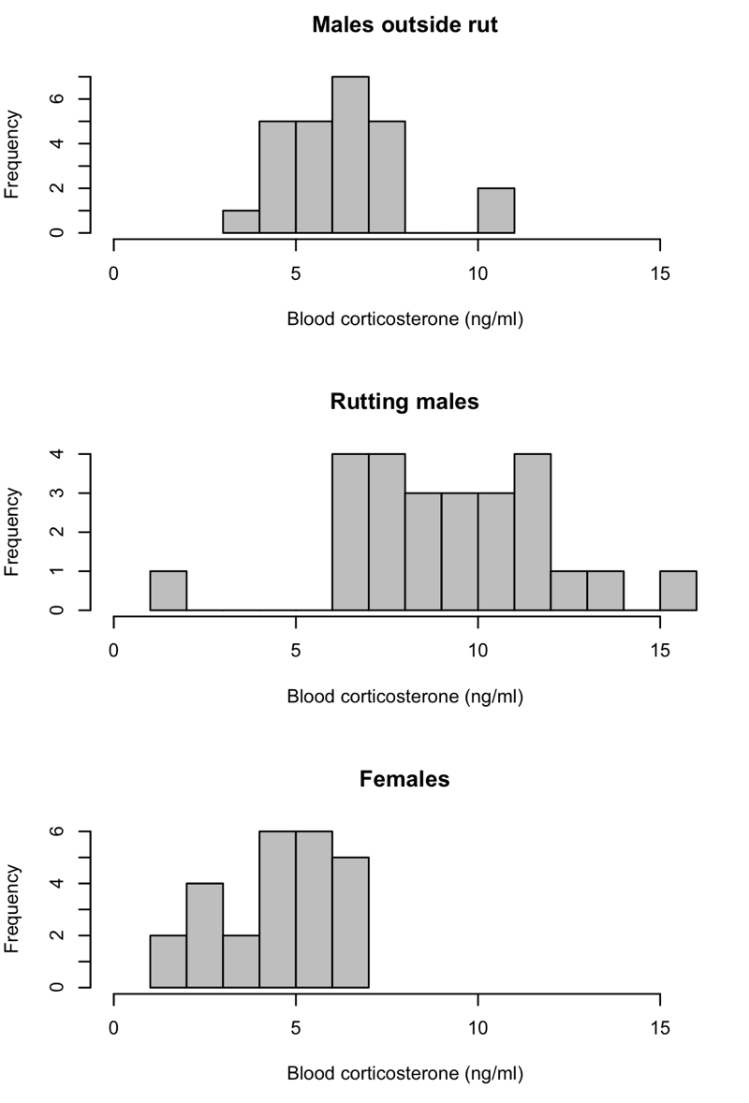
Initial data exploration
Sample | Mean (ng.ml⁻¹) | Variance
Non-rutting males | 6.38 | 2.78
Rutting males | 9.43 | 8.42
Females | 4.49 | 2.82

Slide 27
Initial data exploration
All samples are roughly normally distributed
Rutting males>non-rutting males>females
Is the difference in means between rutting and non-rutting males statistically significant?

Slide 28
Testing the differences between males
We have sampled each male twice, before and during the rut
Therefore, we can express the change in corticosterone titre for each male as the second measurement minus the first

Slide 29
Testing the differences between males
> deer$Males.in.rut-deer$Males
[1] 0.123 3.815 -0.403 8.179 6.266 5.849 0.263 4.492 4.894 2.734 0.733 7.589 5.034 4.179
[15] -1.338 -3.132 -5.721 5.125 1.555 9.207 7.221 0.390 0.746 0.862 8.742
> mean(deer$Males.in.rut-deer$Males)
[1] 3.09616
> sqrt(var(deer$Males.in.rut-deer$Males))
[1] 3.850616

Slide 30
Statistical testing recap
We’re trying to calculate the probability that our value for the mean could arise by random error when sampling from a population with a mean of zero
Null Hypothesis:
There is no difference between samples. The differences between samples are drawn from a population with a mean of zero
Alternative hypothesis:
There is a difference between samples. The differences between samples are drawn from a population with a mean not equal to zero

Slide 31
Calculating t
We can do our statistical test if we calculate a value called “t”, which is defined as the difference in means divided by the standard error
The mean difference between our two samples is 3.10, s=3.85 so
t=X-μ
s/√N
t=3.10-0
3.85/√25
t=3.10/0.77 =4.02

Slide 32
Testing our mean
Using the estimate of the standard deviation causes problems because it will lead to systematic underestimation of σ
This is solved by comparing our value of t with Student’s t distribution, which takes account of this

Slide 33
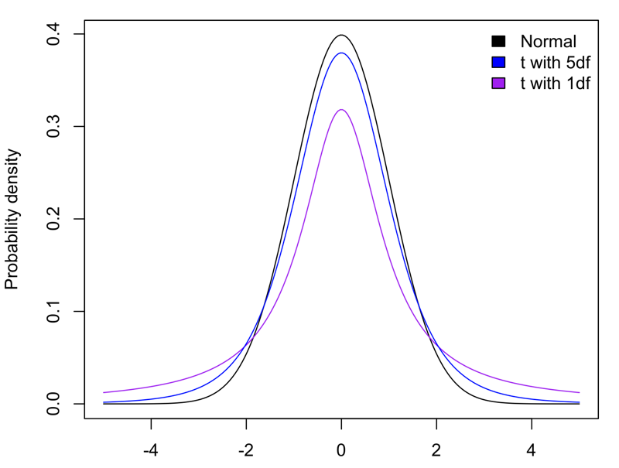
Student’s t-distribution

Slide 34
Testing our means
Our value of is t 4.02 with 24 df
The critical value of t for a 2-tailed test at 24 df is 2.064
Therefore we reject H₀ and accept H₁
Rutting stags have significantly higher corticosterone titres than the same stags sampled before the rut

Slide 35
In R:
use t.test
> t.test(deer$Males.in.rut,deer$Males, paired=TRUE)
Paired t-test
data: deer$Males.in.rut and deer$Males
t = 4.0203, df = 24, p-value = 0.0005005
alternative hypothesis: true difference in means is not equal to 0
95 percent confidence interval:
1.506704 4.685616
sample estimates:
mean of the differences
3.09616

Slide 36
Basic statistical review
Chi-square test, t-test, correlations

Slide 37
2 types of statistical test
Comparisons
Relationships

Slide 38
Correlation
Relationships or associations between continuous variables
Can be positive or negative
Shows the strength and significance of the relationship between 2 variables

Slide 39
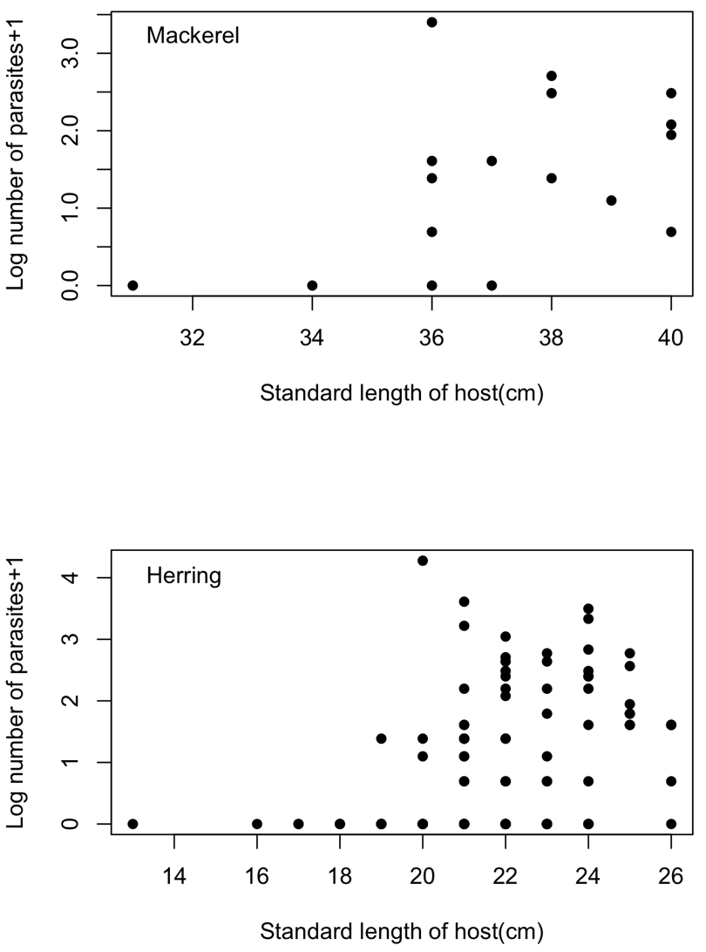
Data from SBS205 practical

Slide 40
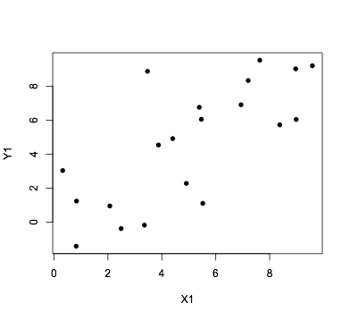
Calculating a correlation coefficient

Slide 41
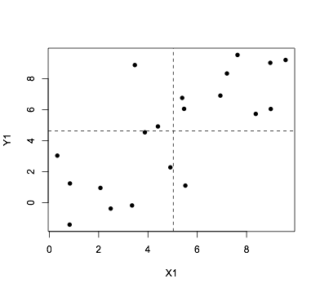


Calculating a correlation coefficient

Slide 42
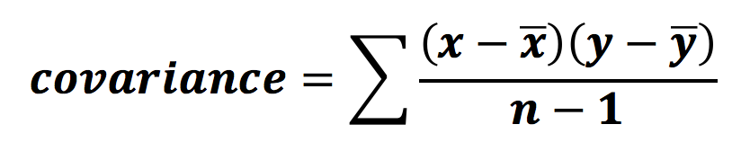
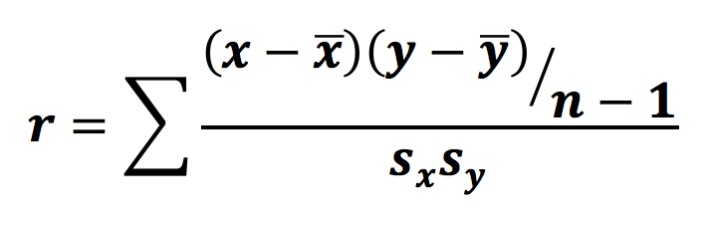
Calculating a correlation coefficient

Slide 43
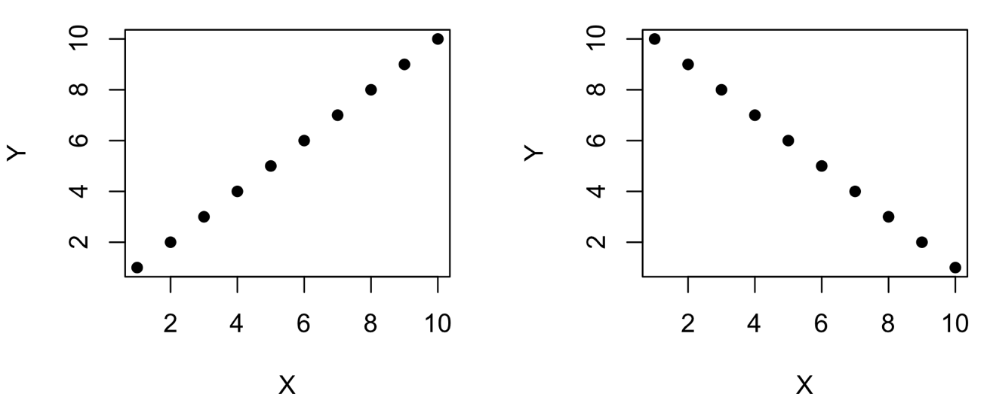
Correlation coefficients
r falls between +1 and -1

Slide 44
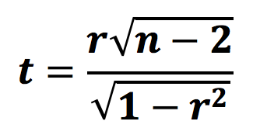
Correlation coefficients: statistical significance
Ho: the two variables are unrelated
Calculate a t-statistic and test at n-2df:

Slide 45
In R:
use cor.test
> Z1<-runif(20,0,10)
> Z2<-Z1+rnorm(20,0,2.5)
> cor.test(Z1,Z2)
Pearson's product-moment correlation
data: Z1 and Z2
t = 2.7642, df = 18, p-value = 0.01278
alternative hypothesis: true correlation is not equal to 0
95 percent confidence interval:
0.1362879 0.7960970
sample estimates:
cor
0.5458861

Slide 46
Correlation coefficients: summary
r varies between +1 and -1. The closer to 1 or -1, the stronger the correlation
We can calculate a p-value associated with r to allow us to test for a statistically significant correlation
Coefficient of determination, r², is an estimate of the % variability in one variable explained by the other variable

Slide 47
Note: correlation does NOT mean causality
If two variables are strongly and significantly correlated it does not mean one is the cause of the other

Slide 48
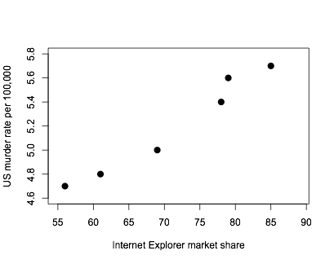

Slide 49
> cor.test(IE,murder)
Pearson's product-moment correlation
data: IE and murder
t = 10.1718, df = 4, p-value = 0.0005261
alternative hypothesis: true correlation is not equal to 0
95 percent confidence interval:
0.8329100 0.9980292
sample estimates:
cor
0.981213

Slide 50
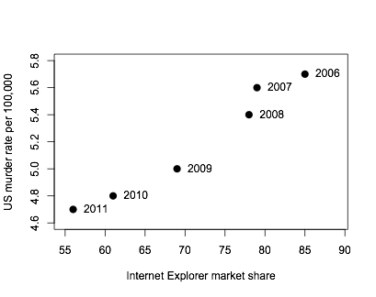
A third variable is correlated with both of our variables

Slide 51
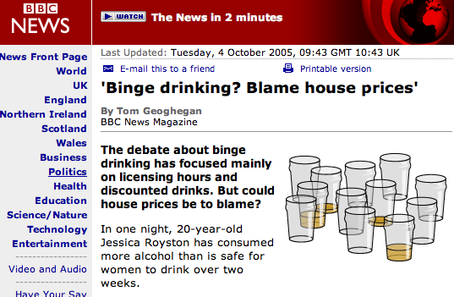
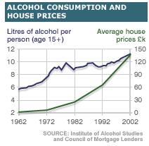

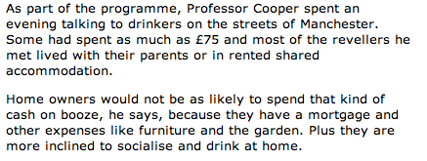

Slide 52
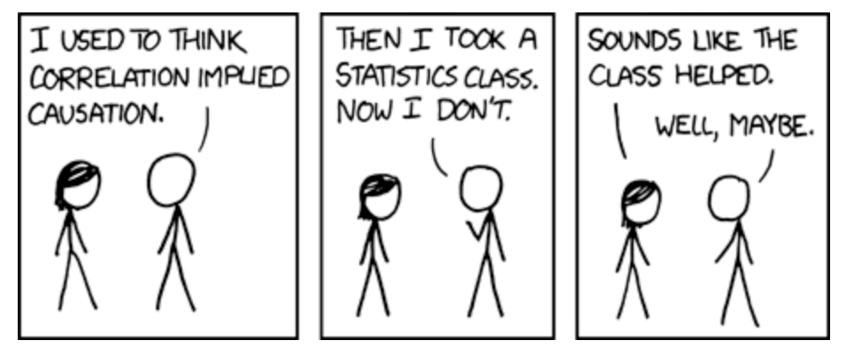
http://xkcd.com/552/

